Slide 1
MAC Restuarant
Developed by: May Magdy
Sara kamal

Slide 2
ErD Model

Slide 3
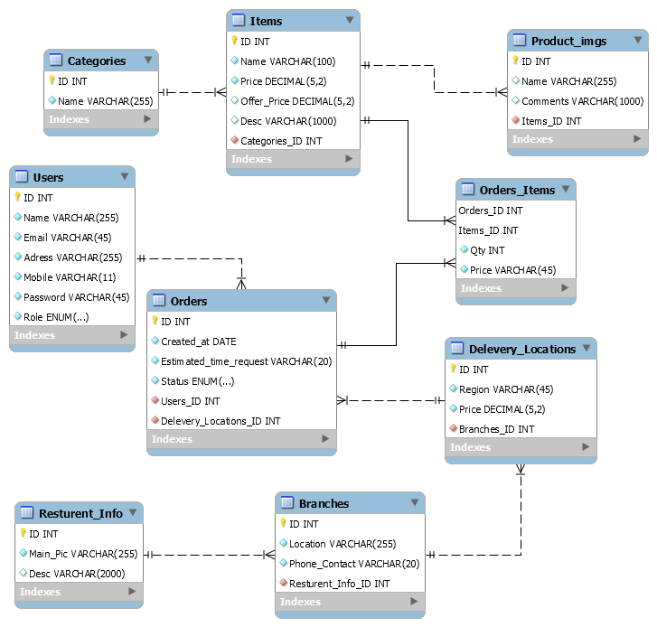

Slide 4
Database tables
Users
Categories
Items
Item_imgs
Orders
Order_items
Resturent_info
Brabches
Deleviry_locations

Slide 5

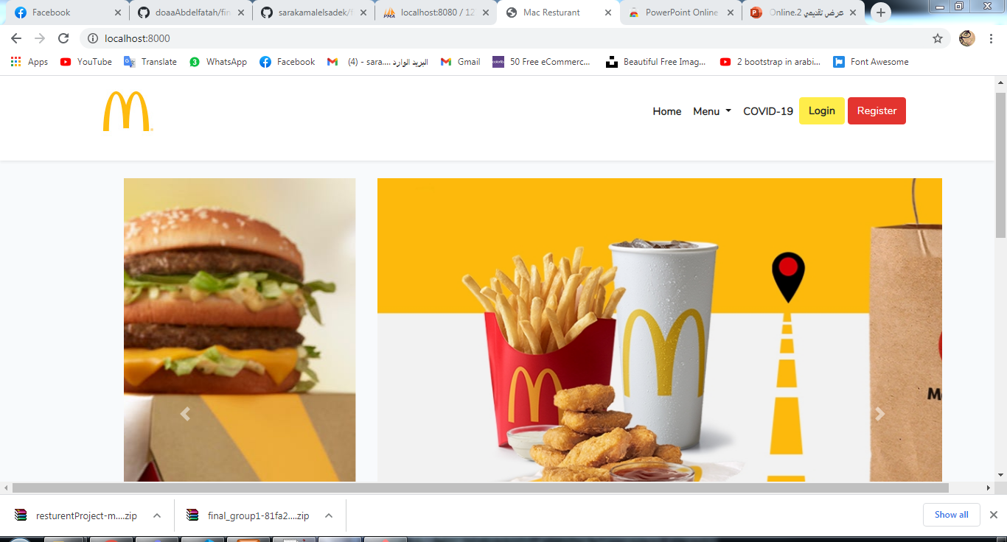
Home page

Slide 6
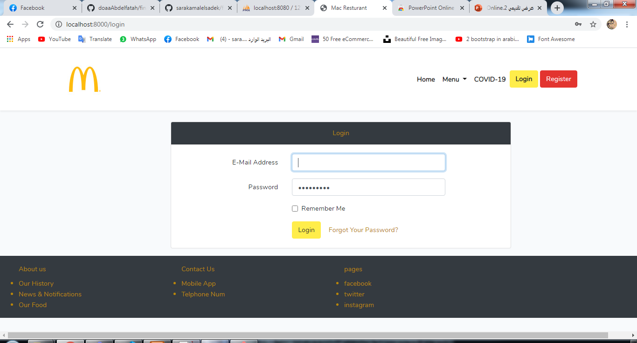
Login Page

Slide 7
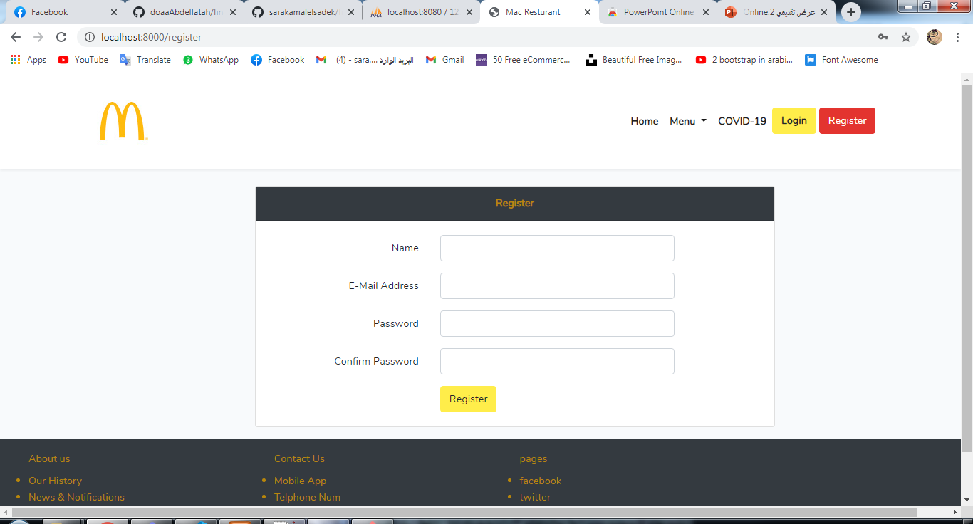
Register Page

Slide 8
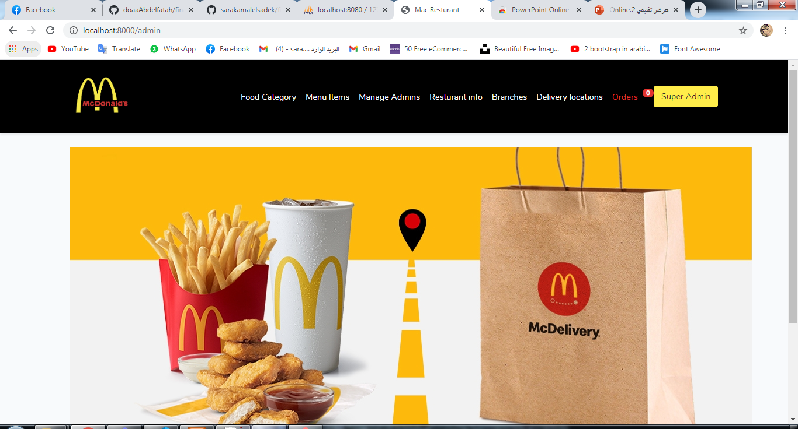
Admin Dashboard

Slide 9
Admin Can:
dd Food Category
Add menu items
Add New admin
Add resturent infos
Add new branch
Receive orders

Slide 10
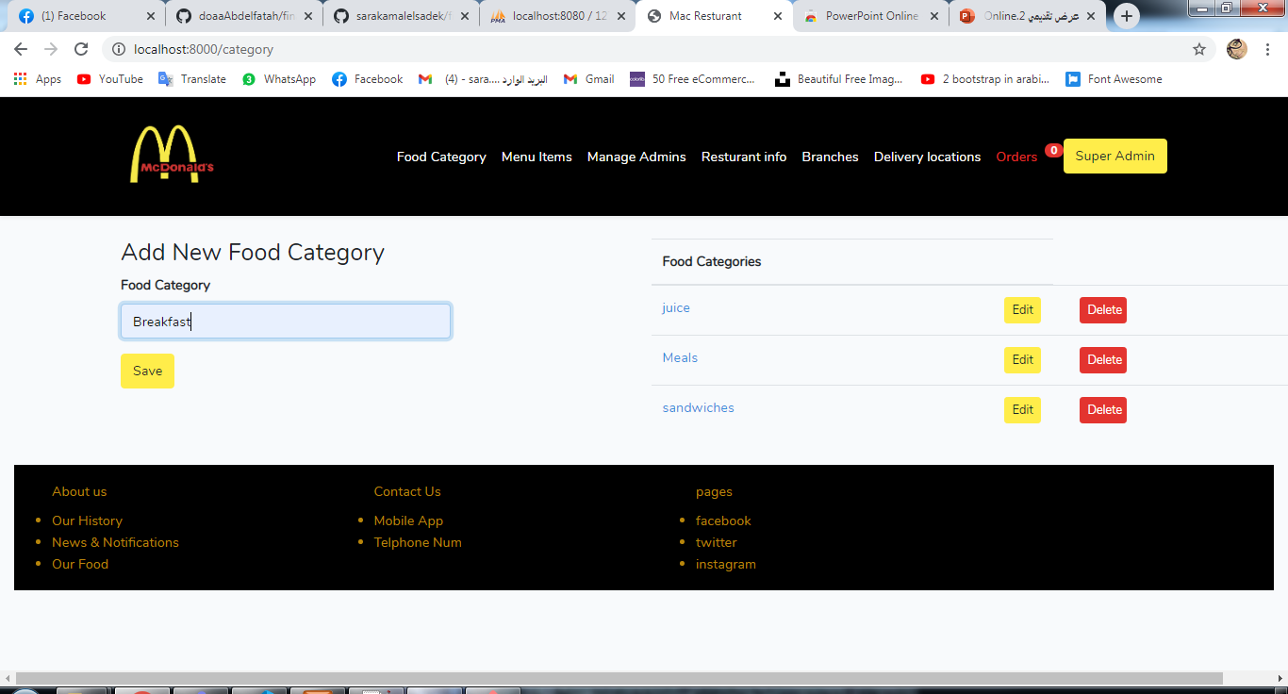
Category control :

Slide 11
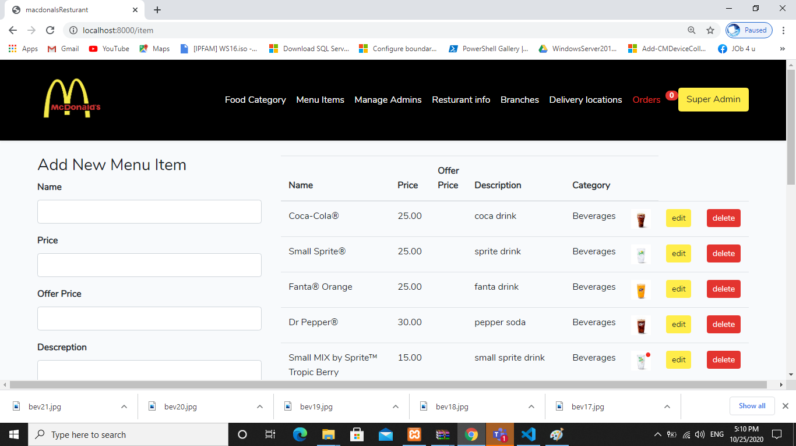
Menu Items Contol:

Slide 12
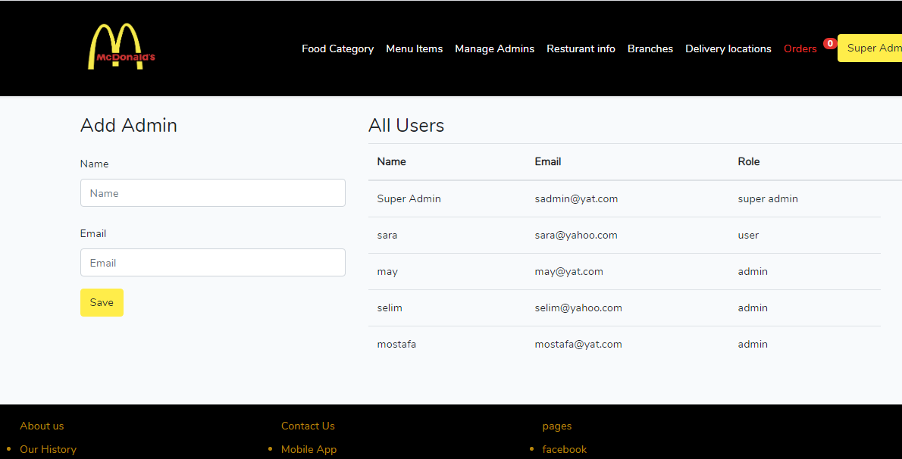
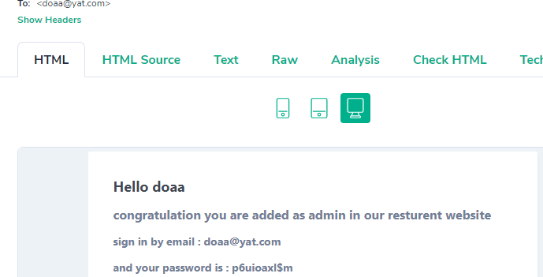
Admin control:

Slide 13
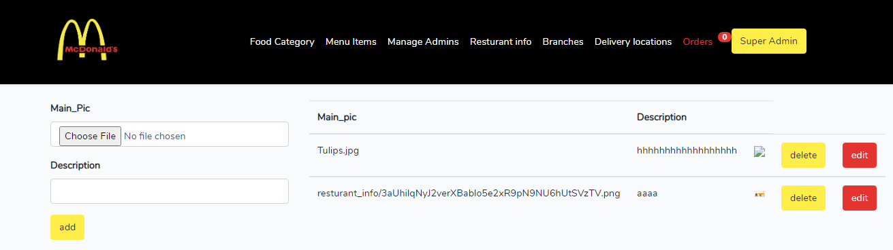
Resturant info control:

Slide 14
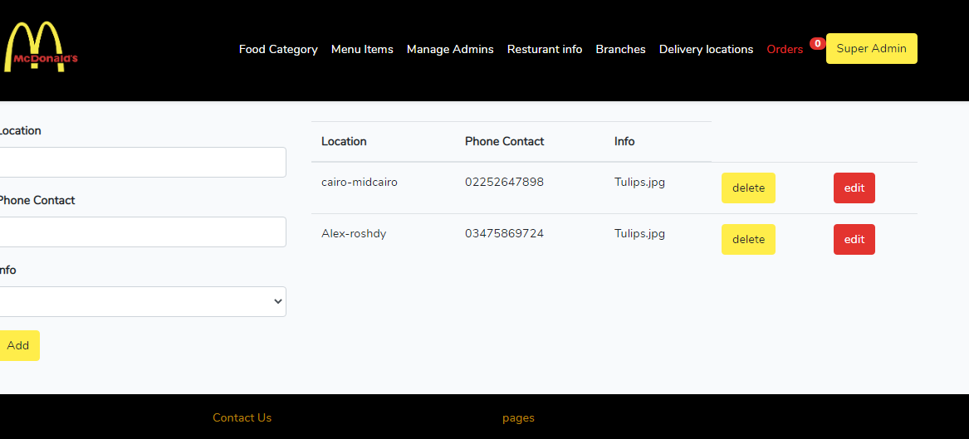
Branches control:

Slide 15
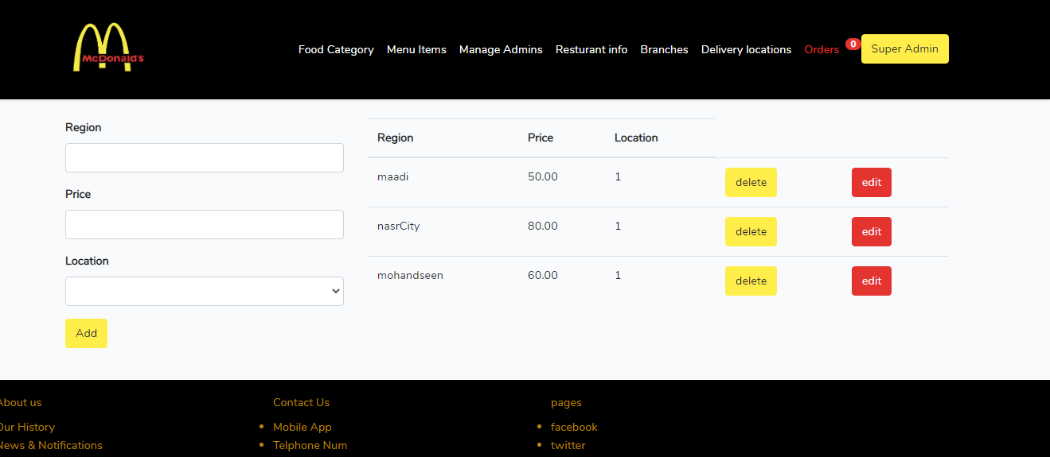
Delivey locations control:

Slide 16
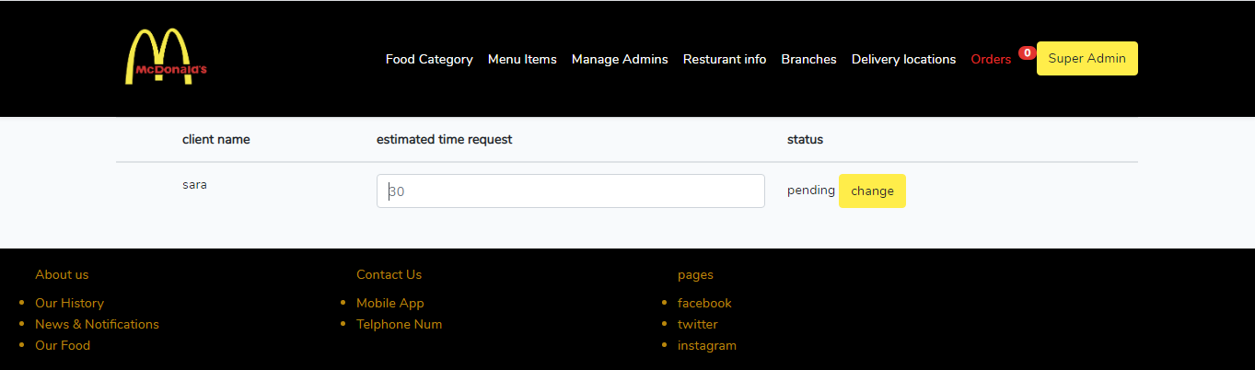
Orders control:

Slide 17
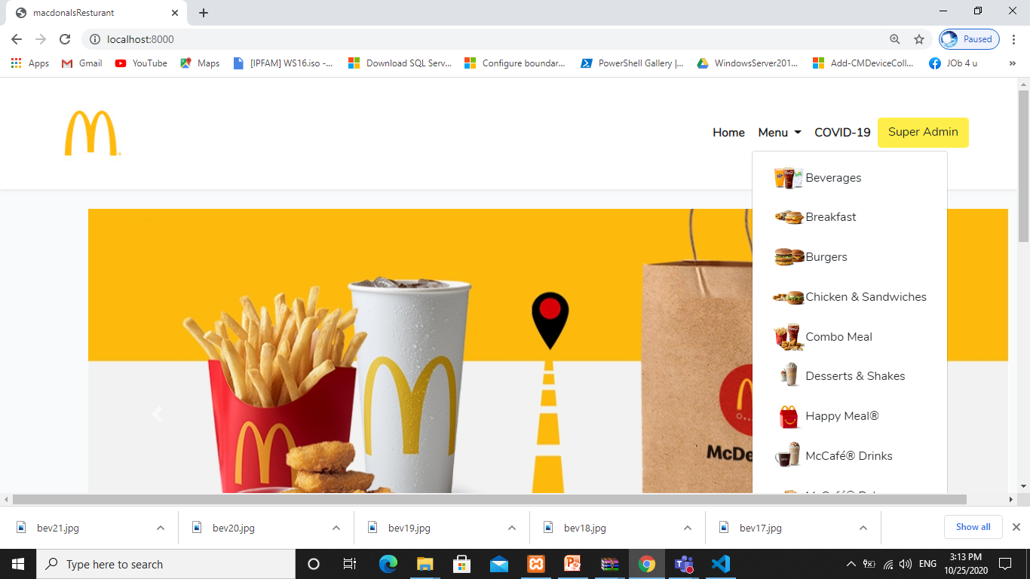
User window

Slide 18
Used tecnologies
Html
Css
Bootstrap
Php
Laravel8
My sql

Slide 19
Thanx :)

